Slide 1

Visual Analysis of Aircraft Crashes
Period : 1908 - 2009
Gautam Worah
Jatin Bindal
Jainil Gada
Gautam Worah
Jatin Bindal
Jainil Gada
Team Name: Spitfire
Dataset used :
Airplane Crashes and Fatalities since 1908

Slide 2
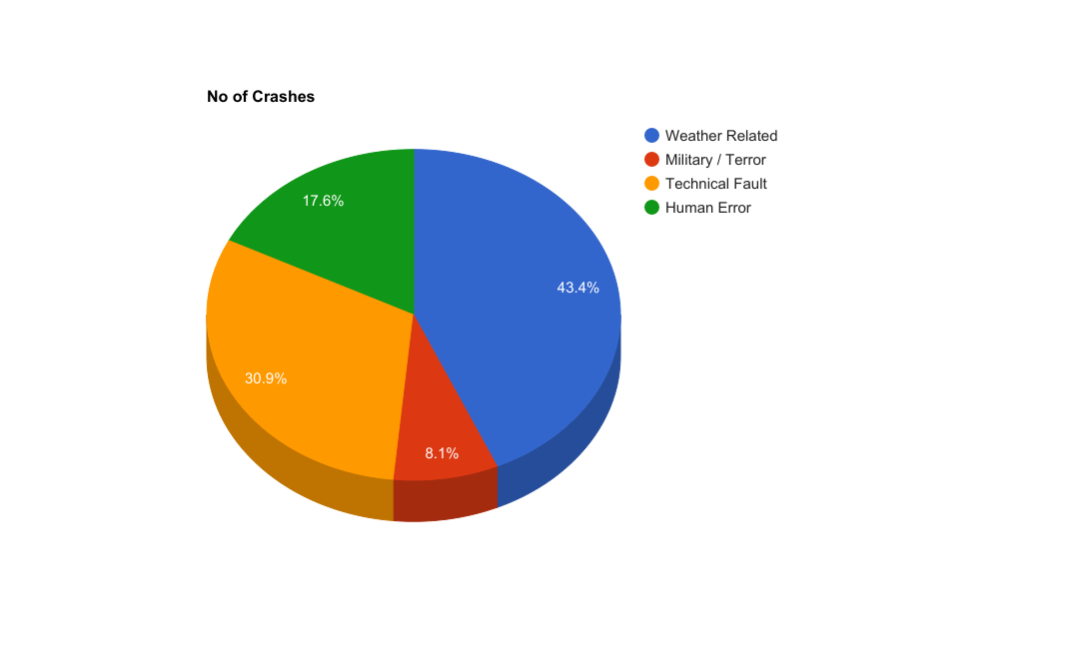
What caused the Crashes?
More than 43% of the plane crashes during 1908 - 2009 occurred due to adverse climatic conditions such as storm , invisibility due to fog, heavy rain, overcast, etc.
Technical faults and failure also contributes to about 31% of the total aircraft accidents.
Human error largely consists of landing , take-off mishaps, miscommunication and judgement errors.

Slide 3
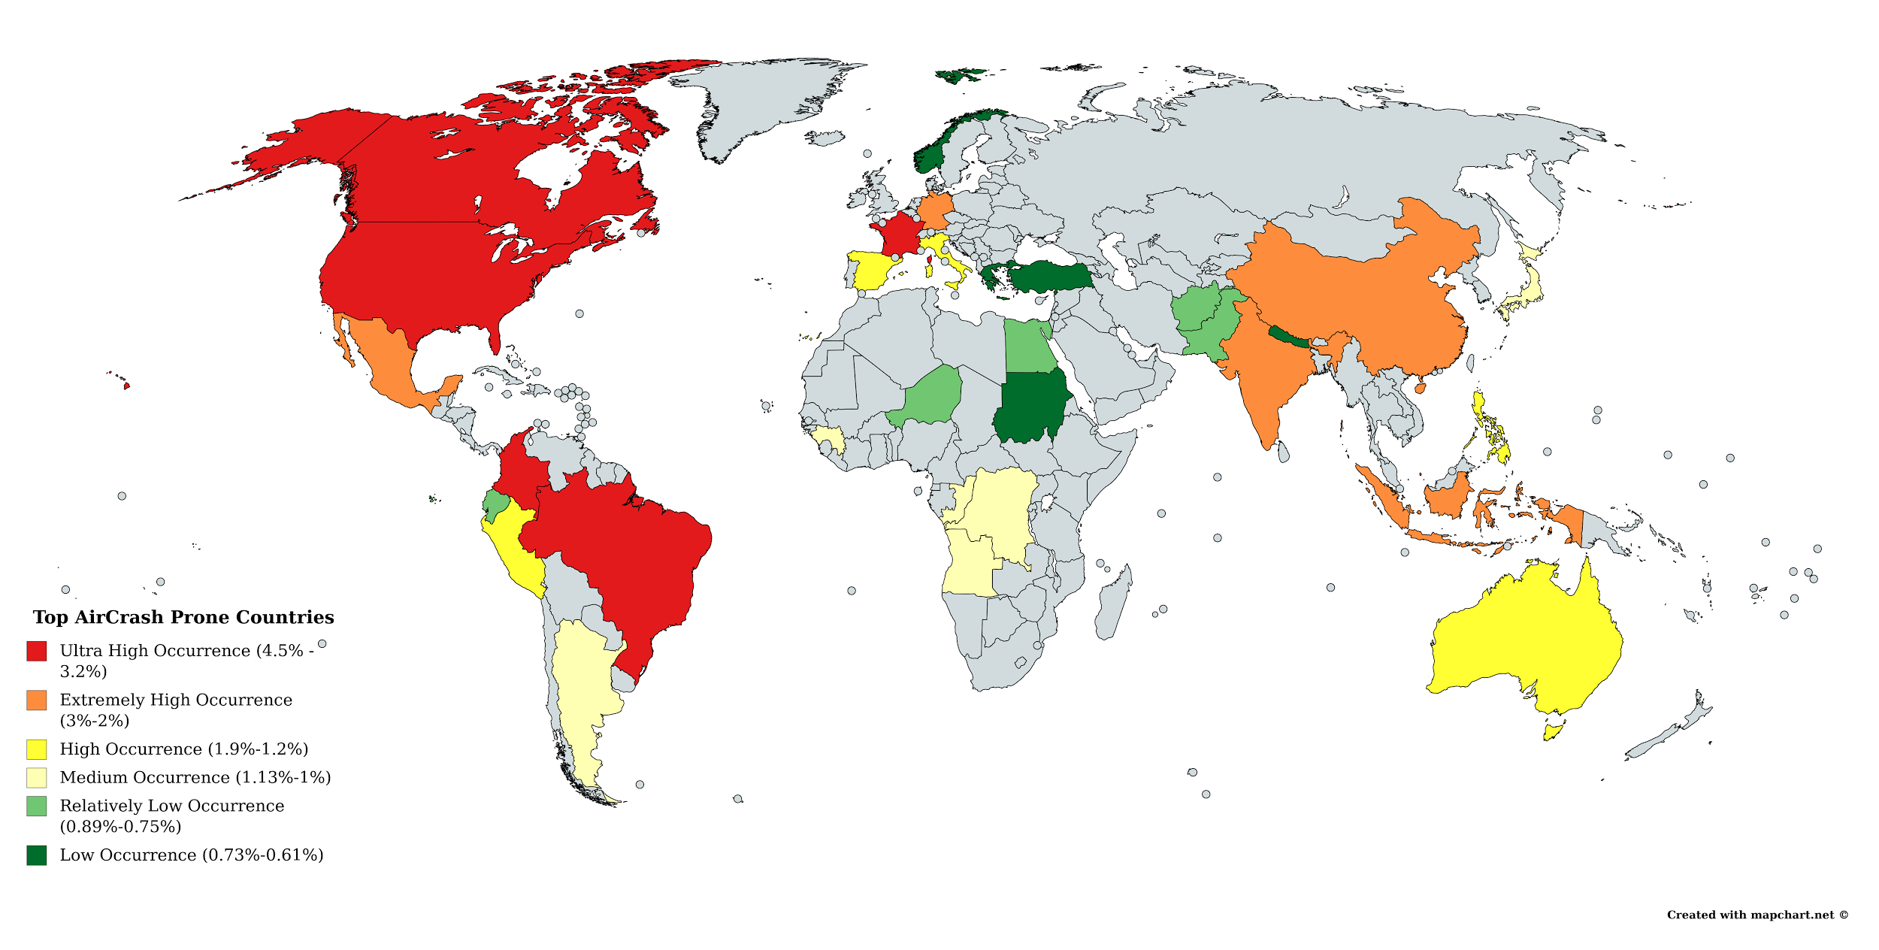
Air Crash Prone Countries!
Brazil, USA, Canada, Colombia, France
India, Mexico, Germany, China, Indonesia
Australia, Italy, Philippines, Spain, Peru
Guinea, Japan, Argentina, Angola, Congo
Egypt, Niger, Ecuador, Afghanistan, Pakistan
Turkey, Norway, Sudan, Greece, Nepal

Slide 4
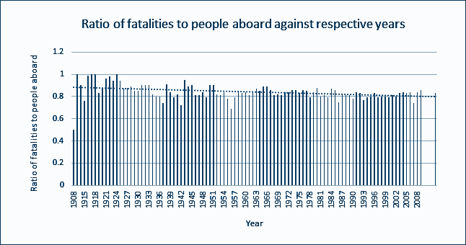
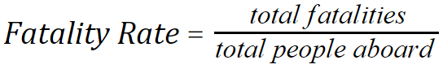
What are my chances of survival?
Until 1924, this ratio was close to 1 and decreased slightly during recent years to reach 0.83.
Tremendous technological enhancements have had very little effect on improving the survival rate due to airplane crashes.

Slide 5
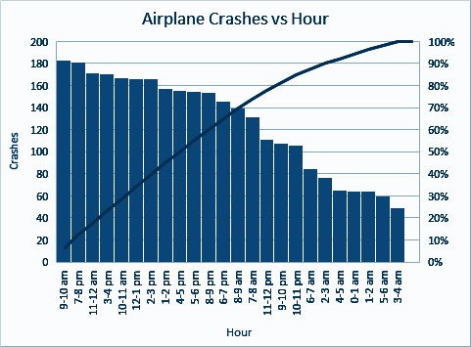
What is the best time to travel?
Least no of crashes have occurred during early morning
and late night.
Surprisingly the 9-10 am slot tops the list followed by 7-8 pm flights and afternoon shifts.
Travelling in the evening nearly doubles the chances of a crash as compared to dawn.

Slide 6
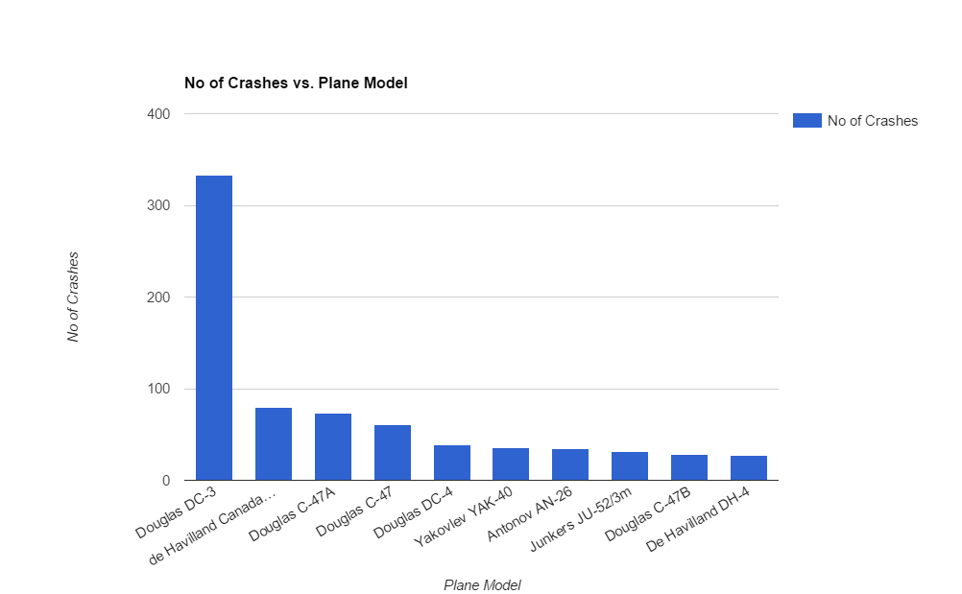
Which Aircraft Model is the most dangerous?
Douglas DC-3 (a fixed-wing propeller-driven commercial airliner) experienced the most no of air crashes - 334.
Other models manufactured by Douglas also indicate a similar trend.
This is further confirmed by the fact that variance of no of crashes of different Operators with Douglas DC-3 is 2.37 (low) indicating that the fault was in the model itself.

Slide 7
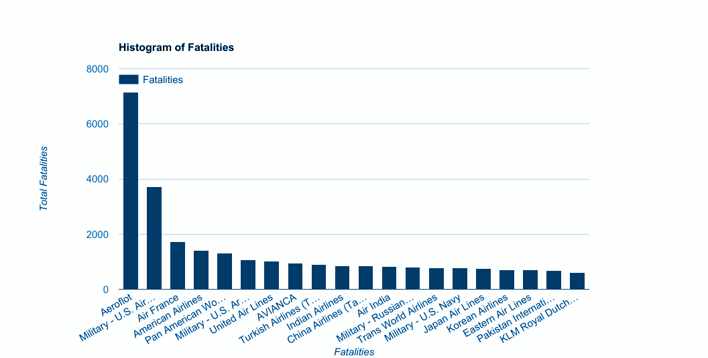
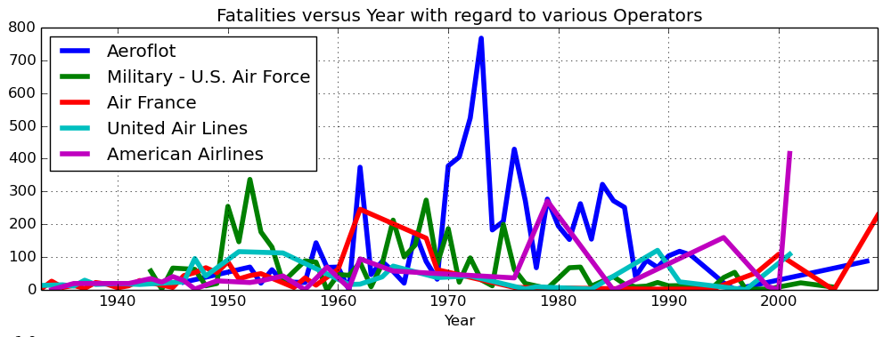
Who should I NOT fly with?
Russian operator Aeroflot has an astonishingly high no of fatalities viz 7156 almost double that of its closest candidate Military -U.S Air.
Fatalities plotted against year gives us an idea about major accidents involving Aeroflot in the late 1970’s.
Period of 1960’s and 1970’s had the maximum no of accidents and casualties in recent years.

Slide 8
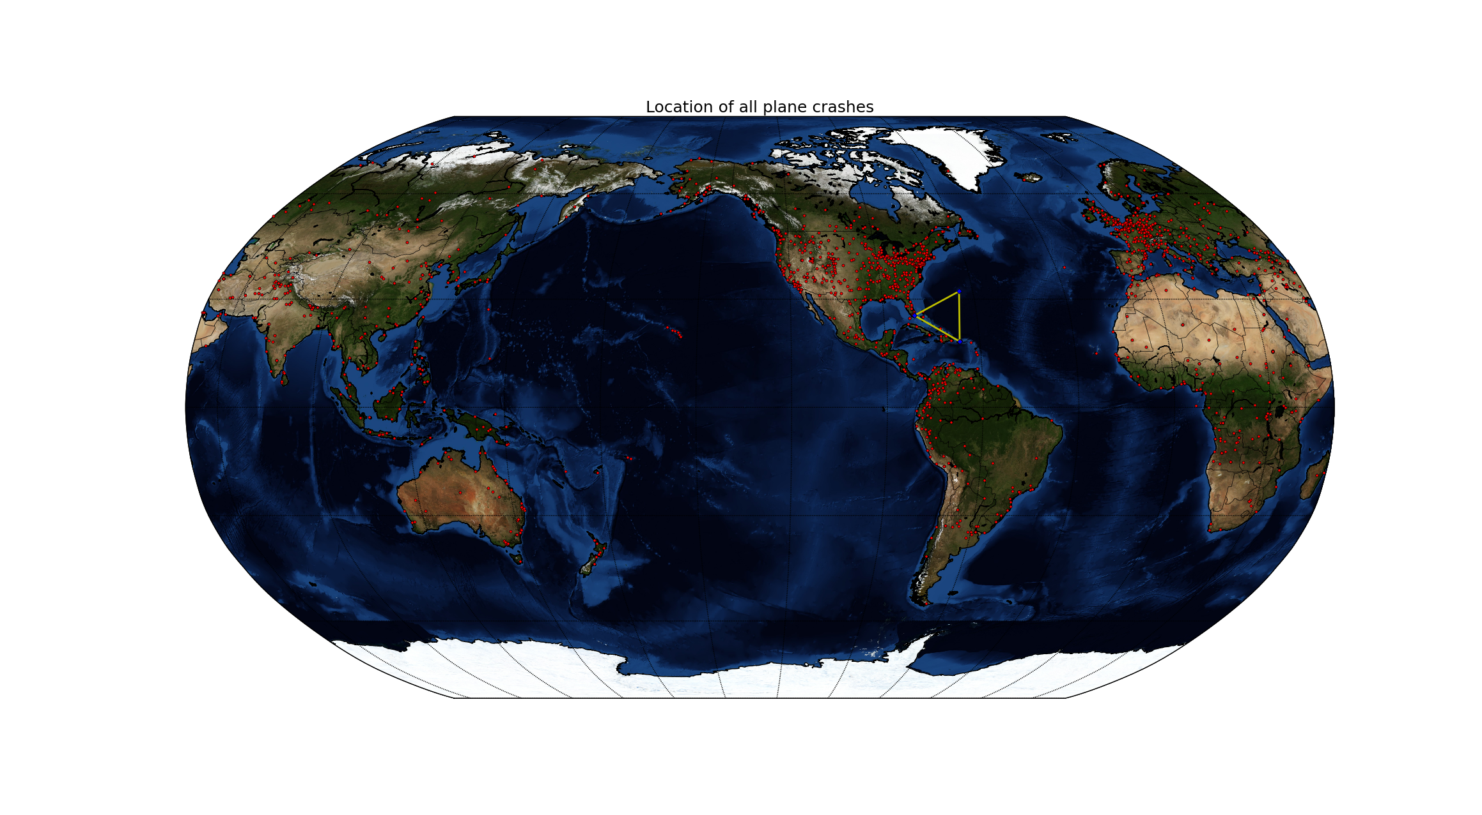
Debunking the Bermuda Myth..
The East Coast of US and Europe clearly shows high crash frequencies as compared to the yellow marked ‘Bermuda Triangle’.
Hawaii has an unusually high no of aircraft incidents.
Trans-Pacific flights show low crash tendencies en-route.
Red markers indicate crash sites.

